Slide 1

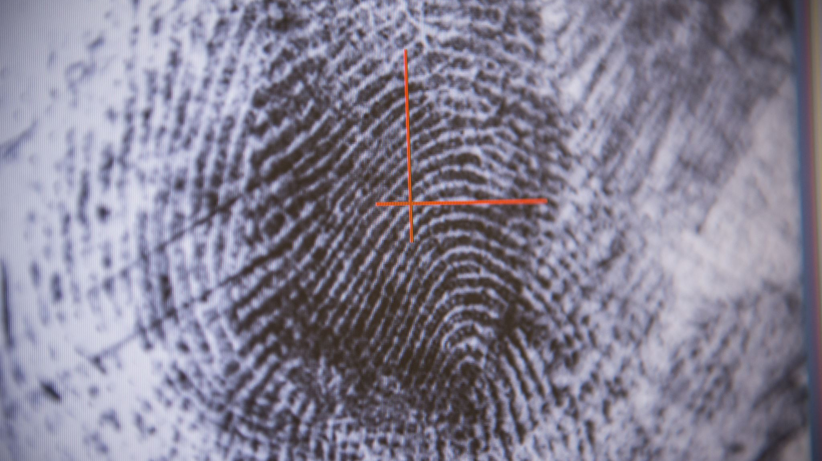
CREDIT CARD FRAUD DETECTION: UNVEILING HIDDEN PATTERNS
Data Mining Project-
Sai Nikhil Varada – G43353336
Yashwanth Raj Varadharajan – G47635180

Slide 2



INTRODUCTION
Credit Card Fraud is a very serious problem that persists in the Banking Industry.
Global losses from credit card fraud are projected to reach $43 billion by 2026.
There are different kinds of Credit Card Frauds –
Card not Present Fraud – Scammers steal a cardholder's credit and personal information – then use it to make purchases online or by phone.
This is very hard to prevent because there is no physical card to examine, and the merchant cannot verify the buyer’s identity.
Credit Card application Fraud –
Criminals use stolen identities information(Name, address, birthday, and social security number) to apply for credit cards. This type of fraud can go undetected until the victim applies for credit themselves or checks their credit report. This type of fraud can damage the victims credit score.

Slide 3
Account takeover –
After stealing personal information, scammers contact credit card companies pretending to be the cardholder. Then they will change the passwords and pin numbers so that they can take over the account.
This type of credit card fraud will be detected when the cardholder tries to use their card or login to their account online.
Credit Card Skimming –
Skimmers are devices that steal the credit card information from the magnetic strip on the back of the card. Scammers attach them to credit cad reader machines in ATMs, retail stores, gas stations.
They either sell the information or use it themselves to make charges to your cards.
Lost or Stolen Card –
This is the most basic credit card fraud schemes is to simply steal someone’s credit card or use a card someone has lost. Thieves also intercept credit cards sent to cardholders in the mail.

Slide 4
DATASET
This dataset presents transactions that have occurred in two days in September 2013 by European cardholders, where we have 492 frauds out of 284,807 transactions.
31 Features – 31 different pieces of information for each transaction, including the time it occurred, the transaction amount, 28 anonymized features and whether it was fraudulent or not.
Highly Imbalanced – 0.172% fraudulent transactions, this reiterates the rarity of fraudulent transactions in the dataset.

Slide 5

Dataset Features
Time: Represents the number of seconds elapsed since the first transaction in the dataset. This feature indicates the relative timing of each transaction.
Amount: The transaction value, representing the monetary amount involved in each transaction.
V1 - V28: A set of 28 anonymized features, transformed using Principal Component Analysis (PCA) to protect user privacy. These features capture underlying patterns in the data while maintaining confidentiality.
Class: The target variable, where 0 indicates a legitimate transaction and 1 indicates a fraudulent transaction. This feature is crucial for training and evaluating the model’s ability to detect fraud.

Slide 6
EXPLORATORY ANALYSIS
During our exploratory data analysis, we identified several key insights that provide a deeper understanding of the dataset:
No Missing Data: The dataset is complete, with no null or missing values across any of the columns.
Average Transaction Value: The average transaction amount is 88 USD, providing a sense of the typical transaction size.
Maximum Transaction Value: The highest recorded transaction value in the dataset is 25,691.16 USD, indicating a significant outlier or potential high-value transactions.
These findings offer important context for the dataset and will guide the subsequent modeling and analysis process.

Slide 7
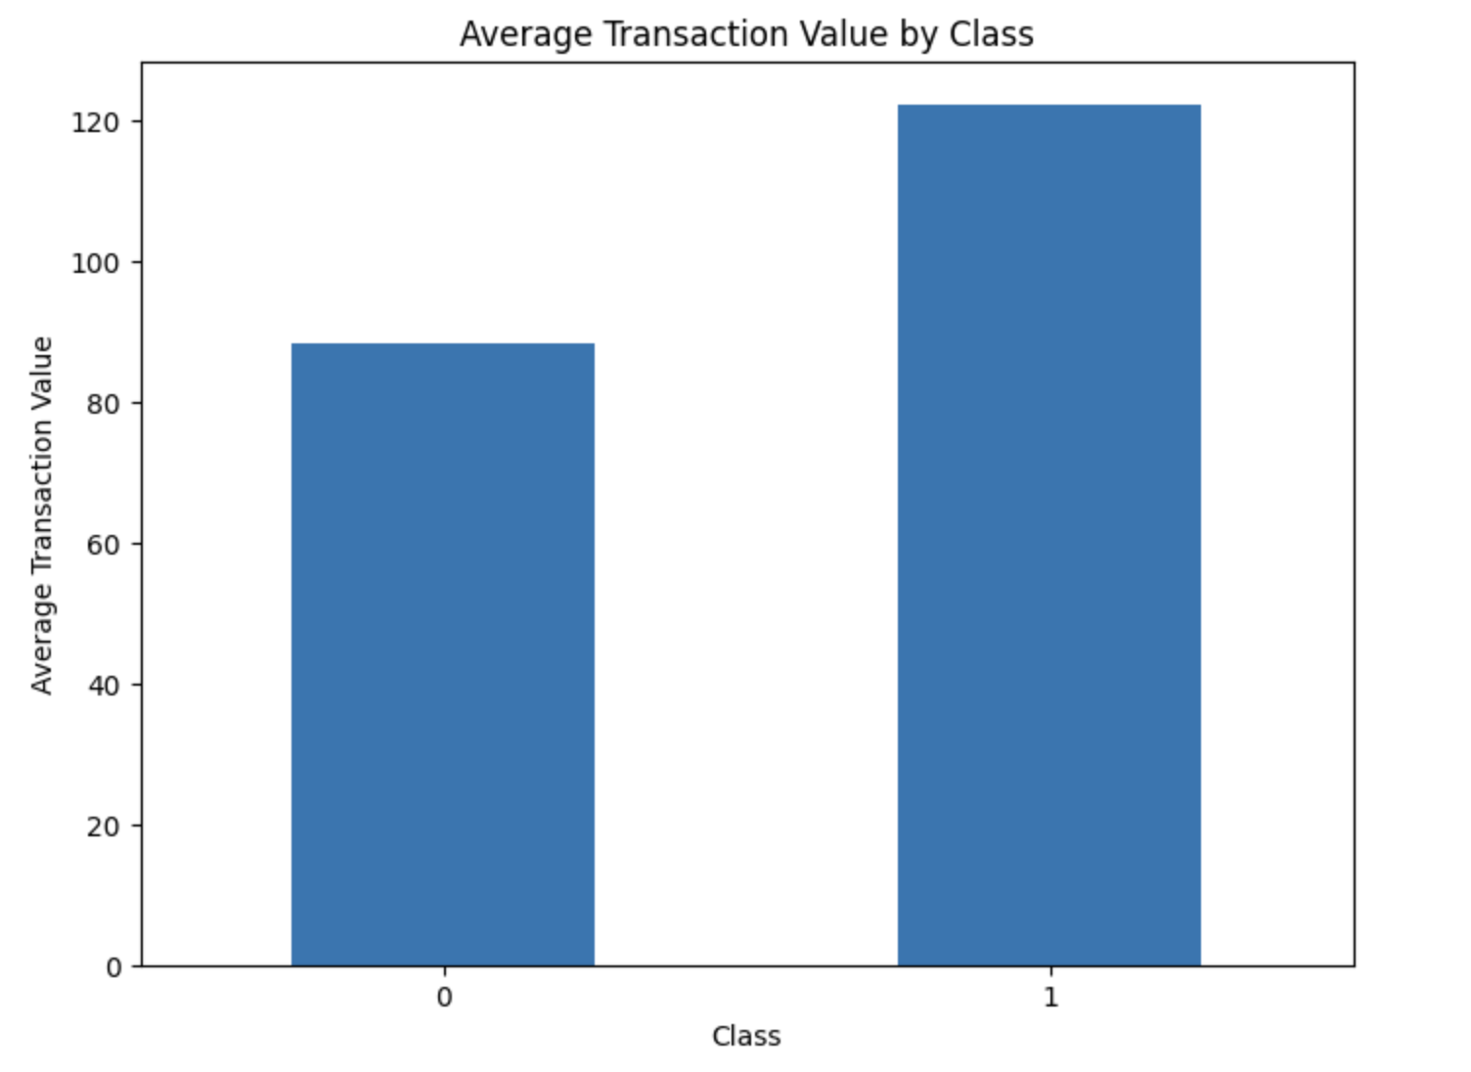
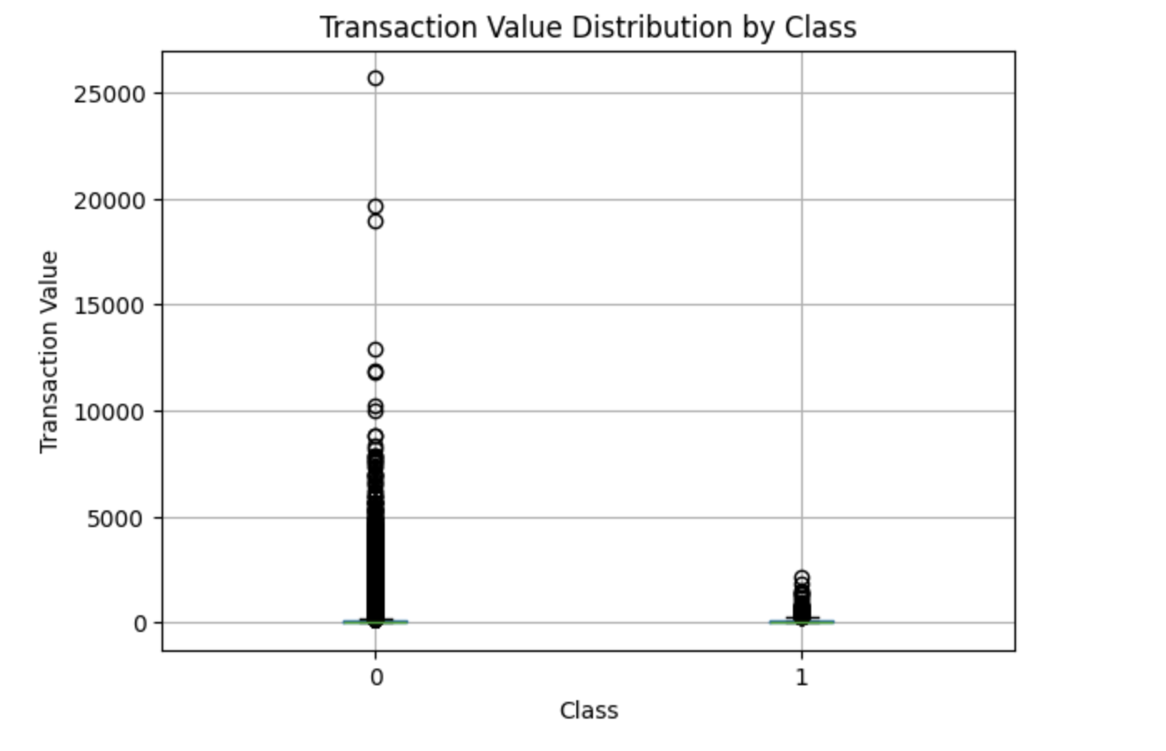
Transaction analysis
The dataset reveals interesting statistics when comparing the transaction amounts for the two classes: non-fraudulent (Class 0) and fraudulent (Class 1). For fraudulent transactions, the average transaction amount is significantly higher at 122.21 compared to 88.29 for non-fraudulent transactions. However, the median transaction amount tells a different story, with non-fraudulent transactions having a median of 22.00 while fraudulent transactions exhibit a much lower median of 9.25, indicating a skewed distribution. The minimum transaction amount is 0.0 for both classes, but the maximum varies greatly, reaching 25,691.16 for non-fraudulent transactions and 2,125.87 for fraudulent ones. These statistics highlight that fraudulent transactions tend to involve smaller amounts, potentially reflecting an effort to avoid detection.

Slide 8
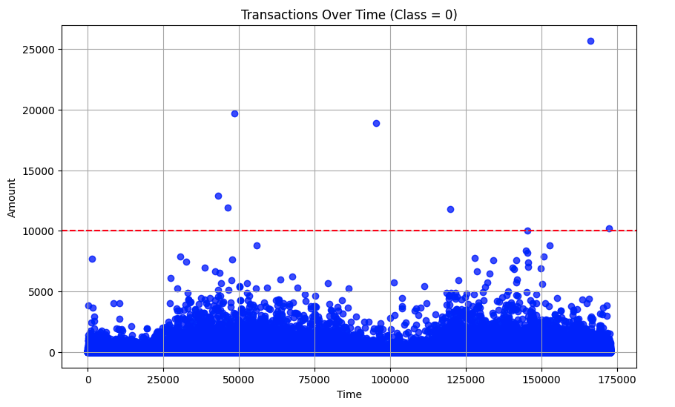
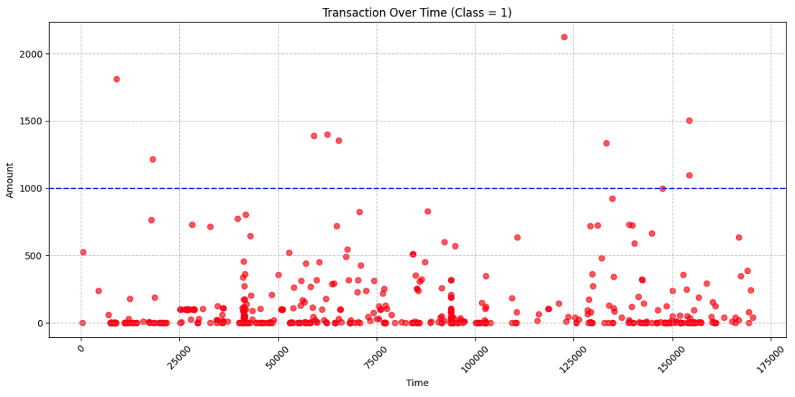
Transaction Analysis
The analysis of transaction times for both fraudulent (Class 1) and non-fraudulent (Class 0) transactions reveals intriguing patterns. Among transactions with amounts greater than 10,000, there are 8 non-fraudulent transactions and amount greater than 1000, there are 9 fraudulent transactions. This observation is noteworthy, as high-value fraudulent transactions are slightly more frequent than high-value non-fraudulent ones, contradicting the common assumption that fraud typically involves smaller amounts.

Slide 9
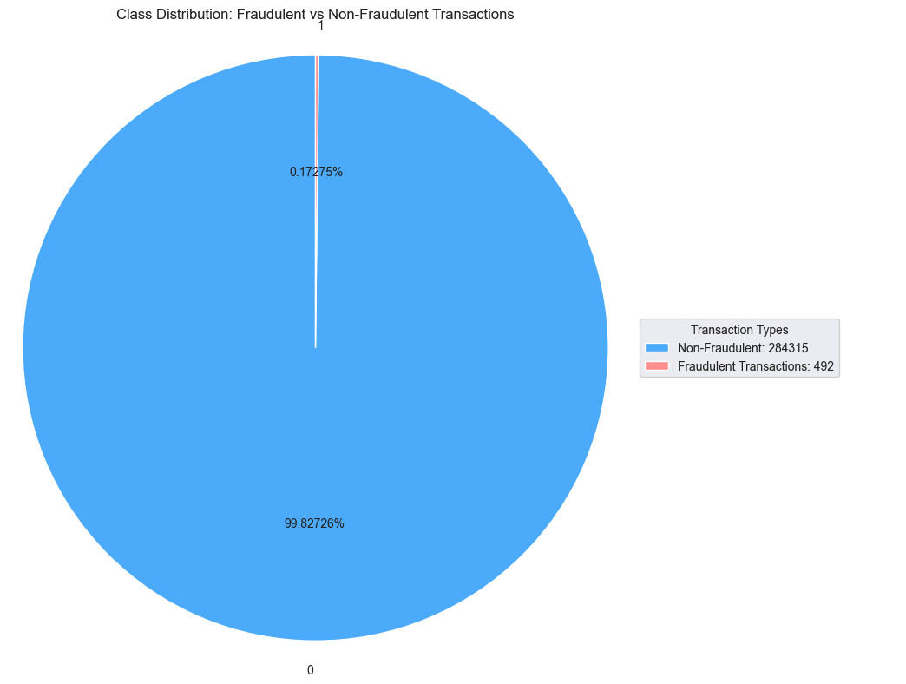
Class Imbalance
The dataset consists of 284,807 transactions, of which only 492 are classified as fraudulent. This significant class imbalance poses a challenge for model training, as the model is likely to be biased towards predicting the majority class non-fraudulent transactions. With fraudulent transactions representing only 0.172% of the total dataset, the model may struggle to accurately detect fraud, often predicting all transactions as non-fraudulent due to the overwhelming proportion of the majority class.

Slide 10
DATA PREPROCESSING
Outlier Removal: Outliers are removed from the dataset to enhance model performance by eliminating extreme values that could skew predictions or disrupt learning.
Feature Scaling: To ensure effective analysis, the Time and Amount columns are scaled, as all other features (except the Class column) are derived from Principal Component Analysis (PCA). Robust Scaler was used to scale the features in the dataset, particularly focusing on the 'Time' and 'Amount' columns, to reduce the impact of outliers.
Balancing the Dataset: Given the highly imbalanced nature of the dataset, it is essential to address the class imbalance to prevent the model from overfitting to the majority class. In this project, we applied various resampling techniques, including SMOTE, Random Over-Sampling, ADASYN, Borderline-SMOTE, and SMOTETomek, to balance the dataset. These methods generated synthetic samples for the minority class (fraudulent transactions) or duplicated samples for the majority class (non-fraudulent transactions) to ensure an equal distribution between the classes, thereby improving the model's ability to detect fraudulent transactions effectively.

Slide 11
REMOVING OUTLIERS
To improve the model’s performance and ensure robust predictions, outliers were removed from the dataset using the following criteria:
Class 0 (Non-Fraudulent Transactions): Transactions with an Amount greater than 10,000 were identified as outliers and excluded.
Class 1 (Fraudulent Transactions): Transactions with an Amount greater than 1,000 were treated as outliers and removed from the dataset.
This process effectively filtered out extreme values that could skew the model's learning process. As a result:
13 rows were removed from the training data.
The dataset size was reduced from 227,845 rows to 227,832 rows for both features and labels.
By eliminating these outliers, the dataset becomes more representative of typical transaction patterns, which helps the model make better predictions.

Slide 12
SCALING TIME AND AMOUNT COLUMNS
To prepare the dataset for effective model training, scaling and additional outlier removal were performed in two phases:
Feature Scaling:
Since most features were already scaled (due to PCA transformation), the remaining Time and Amount columns were scaled using the RobustScaler technique.
RobustScaler was chosen for its ability to handle outliers by scaling data based on the interquartile range (IQR), making it robust to extreme values.
By combining scaling and outlier removal, the dataset is now better optimized for training, with more uniform feature contributions and fewer extreme values that could disrupt the model’s learning process.

Slide 13
Dealing with the dataset imbalance
Given the highly imbalanced nature of the dataset, where the majority class (non-fraudulent transactions) significantly outnumbers the minority class (fraudulent transactions), it was crucial to address this imbalance to prevent the model from being biased towards the majority class. Various over-sampling techniques were applied to balance the dataset effectively:
1. Synthetic Minority Oversampling Technique (SMOTE):
SMOTE generates synthetic samples for the minority class by interpolating between existing minority class samples.
This method balances the dataset by ensuring that both classes have an equal number of samples.
Result:
Non-Fraudulent Transactions (Class 0): 227,446
Fraudulent Transactions (Class 1): 227,446
2. Random Oversampling:
In this technique, random duplication of samples from the minority class was performed until the class distribution was balanced.
While effective, this method may introduce overfitting due to repeated instances of the same data points.
Result:
Non-Fraudulent Transactions (Class 0): 227,446
Fraudulent Transactions (Class 1): 227,446

Slide 14
Dealing with the dataset imbalance
3. Adaptive Synthetic Sampling (ADASYN):
ADASYN works similarly to SMOTE but focuses on creating more synthetic samples for the minority class in regions where the minority class is underrepresented relative to the majority class.
This approach generates a slightly uneven balance but is adaptive to the data distribution.
Result:
Non-Fraudulent Transactions (Class 0): 227,446
Fraudulent Transactions (Class 1): 227,424
4. Borderline-SMOTE:
This variant of SMOTE focuses on generating synthetic samples near the borderline of the classes, where classification is most challenging.
It ensures balanced data while focusing on regions that are more critical for decision-making.
Result:
Non-Fraudulent Transactions (Class 0): 227,446
Fraudulent Transactions (Class 1): 227,446

Slide 15
Dealing with the dataset imbalance
5. SMOTE-Tomek:
This combines SMOTE with Tomek Links, a technique that removes ambiguous data points (those close to the decision boundary) to further enhance the quality of the dataset.
It balances the data while improving class separability by eliminating noise.
Result:
Non-Fraudulent Transactions (Class 0): 227,446
Fraudulent Transactions (Class 1): 227,446
By using these over-sampling techniques, the dataset has been effectively balanced, enabling the model to learn equally from both classes. Among these methods, SMOTE and its variants, such as Borderline-SMOTE and SMOTE-Tomek, are particularly effective due to their ability to generate realistic synthetic samples and address class overlap.

Slide 16
Classification Models for Fraud Detection
In this project, we leveraged several machine learning models to classify fraudulent transactions. Each model was trained using resampled datasets created with different techniques to handle data imbalance, ensuring fair evaluation of their performance.
1. Random Forest Classifier
A robust ensemble learning method that combines multiple decision trees to improve accuracy and prevent overfitting.
Supports class-weighted adjustments to handle imbalanced datasets.
Key Strengths: High accuracy, ability to handle large feature spaces, and interpretability through feature importance.
2. Gradient Boosting Classifier
An ensemble method that builds decision trees sequentially, with each tree correcting errors of its predecessor.
Effective in capturing complex patterns in data.
Key Strengths: High predictive power and resilience to overfitting when tuned correctly.

Slide 17
Classification Models for Fraud Detection
3. XGBoost Classifier
A powerful implementation of gradient boosting optimized for speed and performance.
Incorporates advanced features like regularization to prevent overfitting.
Key Strengths: High efficiency, scalability, and ability to handle imbalanced data using scale_pos_weight.
4. Decision Tree Classifier
A simple, interpretable model that splits data into branches based on feature values.
Adjusted to handle imbalance using class weighting.
Key Strengths: Easy to understand, fast to train, but prone to overfitting without ensemble techniques.
5. Logistic Regression
A baseline statistical model that predicts probabilities based on a linear combination of input features.
Adjusted for imbalance using class weighting.
Key Strengths: Interpretability and low computational cost, making it ideal for baseline comparisons.

Slide 18
Process overview
Resampling Methods:
Five resampling techniques—SMOTE, Random Oversampling, ADASYN, Borderline-SMOTE, and SMOTE-Tomek—were applied to balance the data. Each resampled dataset was used to train and evaluate the models.
Evaluation Metrics:
PR AUC (Precision-Recall Area Under the Curve): PR AUC was the primary evaluation metric used to assess the model's performance. It focused on the trade-off between precision and recall, particularly important for imbalanced datasets like credit card fraud detection. A higher PR AUC indicates a model's ability to correctly identify fraudulent transactions while minimizing false positives. The PR AUC scores were calculated for each classifier across different resampling techniques, providing insights into how well each model performed in detecting fraud.
Training and Evaluation Loop:
Each resampled dataset was paired with each classifier.
Models were trained on the resampled data (X_train, y_train) and tested on the unseen test set (X_test, y_test).
Results, including weighted F1-scores and AUC values, were recorded for each combination of resampling method and classifier.

Slide 19
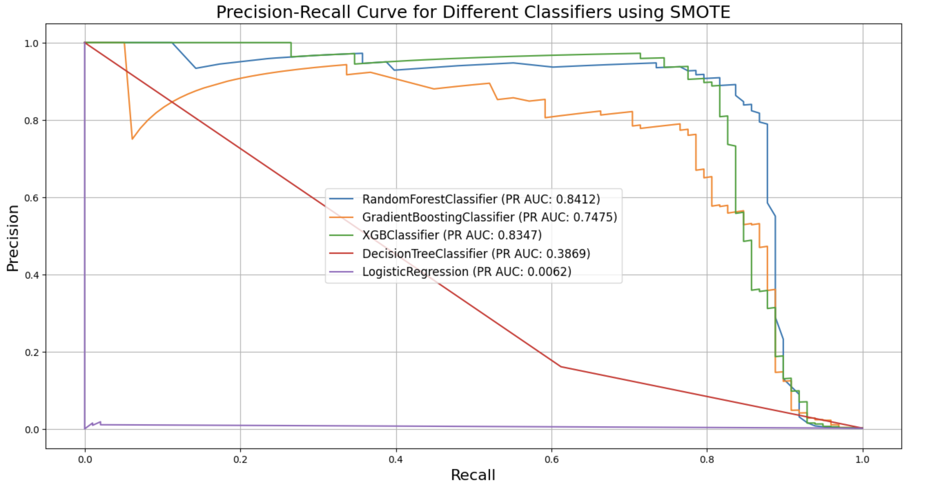
Model Performance with SMOTE

Slide 20
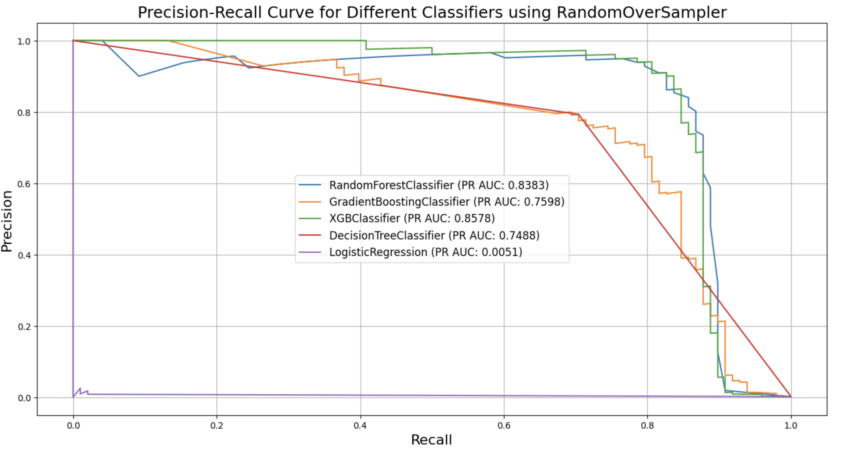
Model Performance with Random over sampler

Slide 21
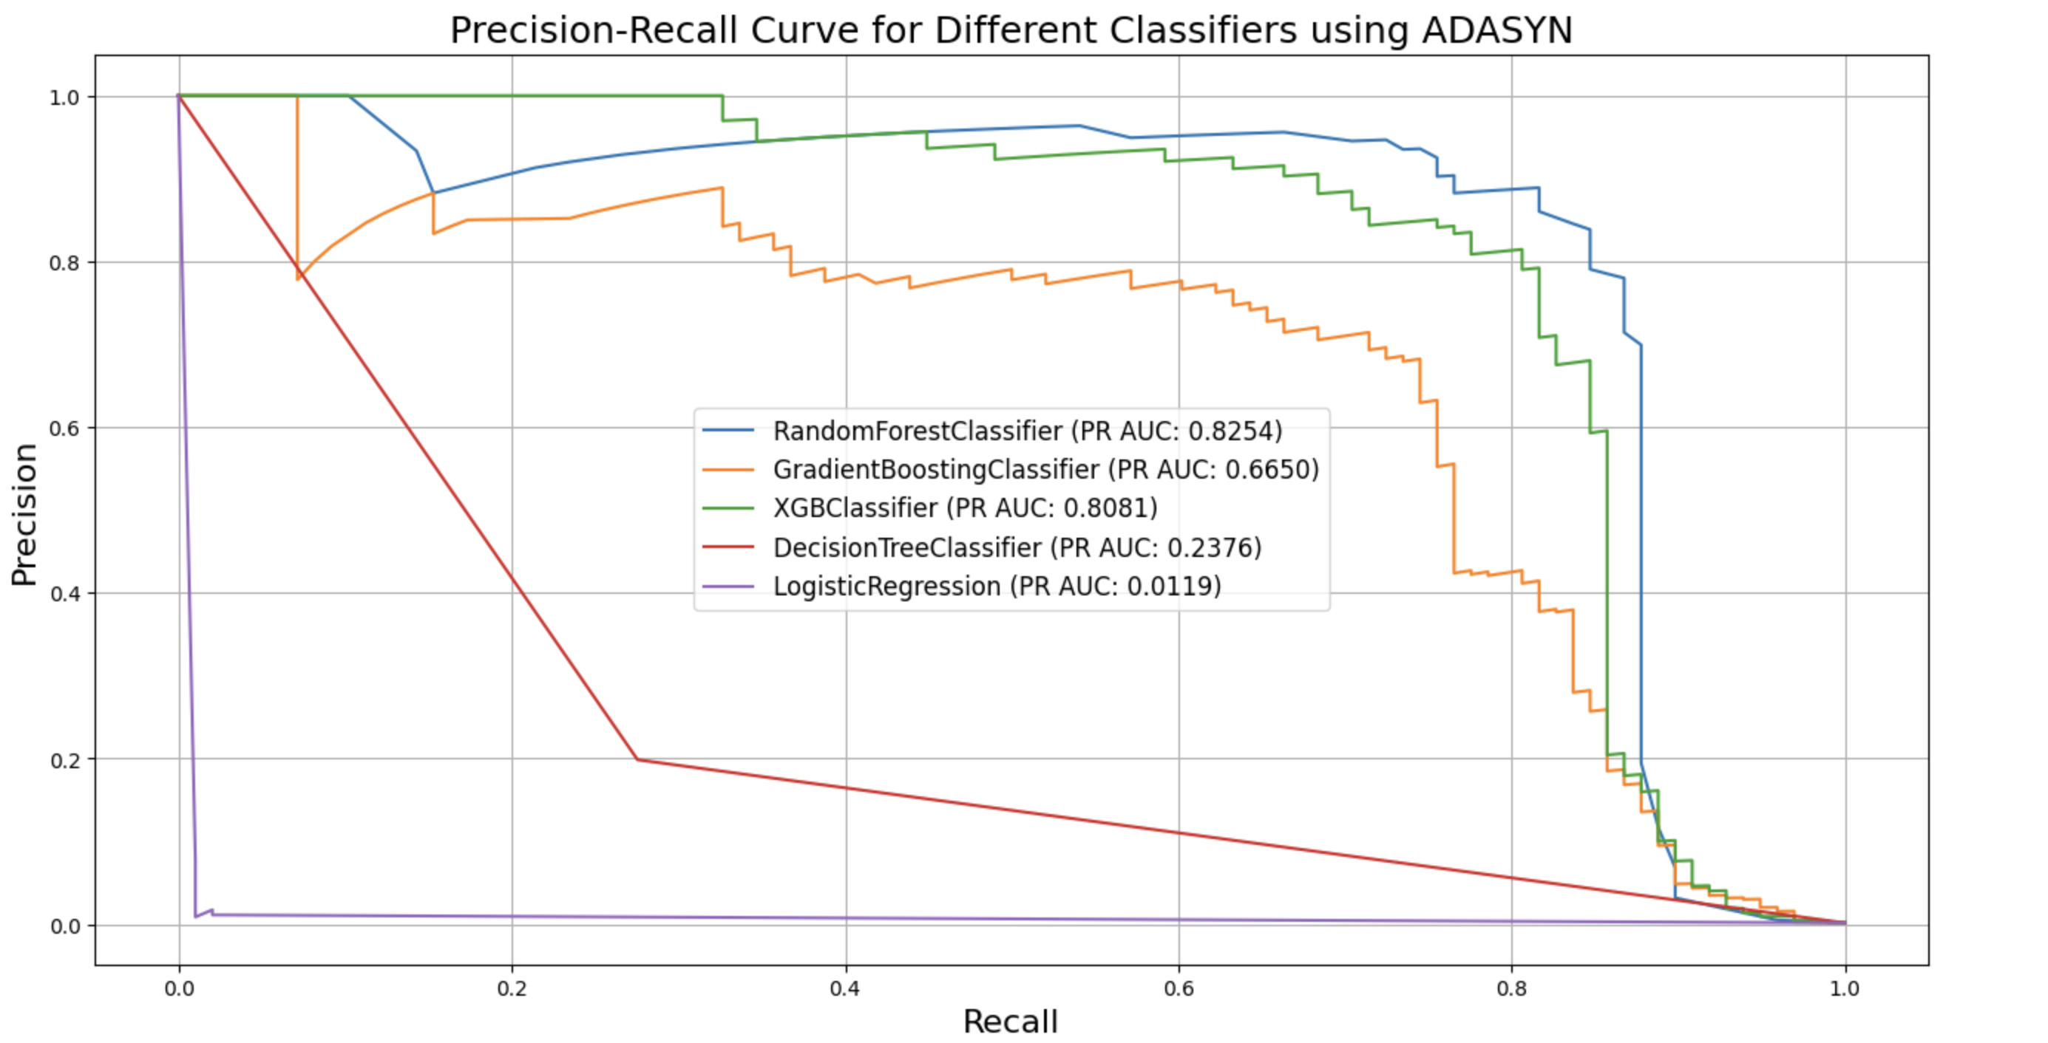
Model Performance with ADASYN

Slide 22
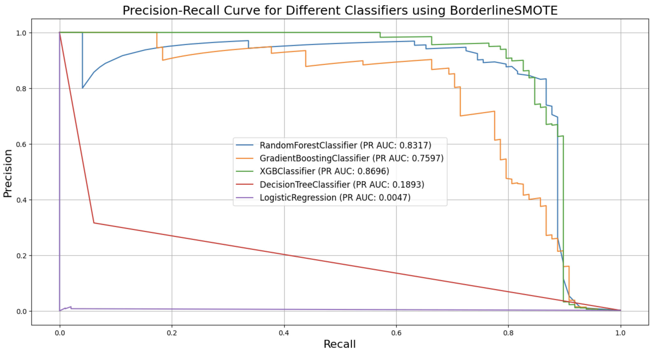
Model Performance with Borderline SMOTE

Slide 23
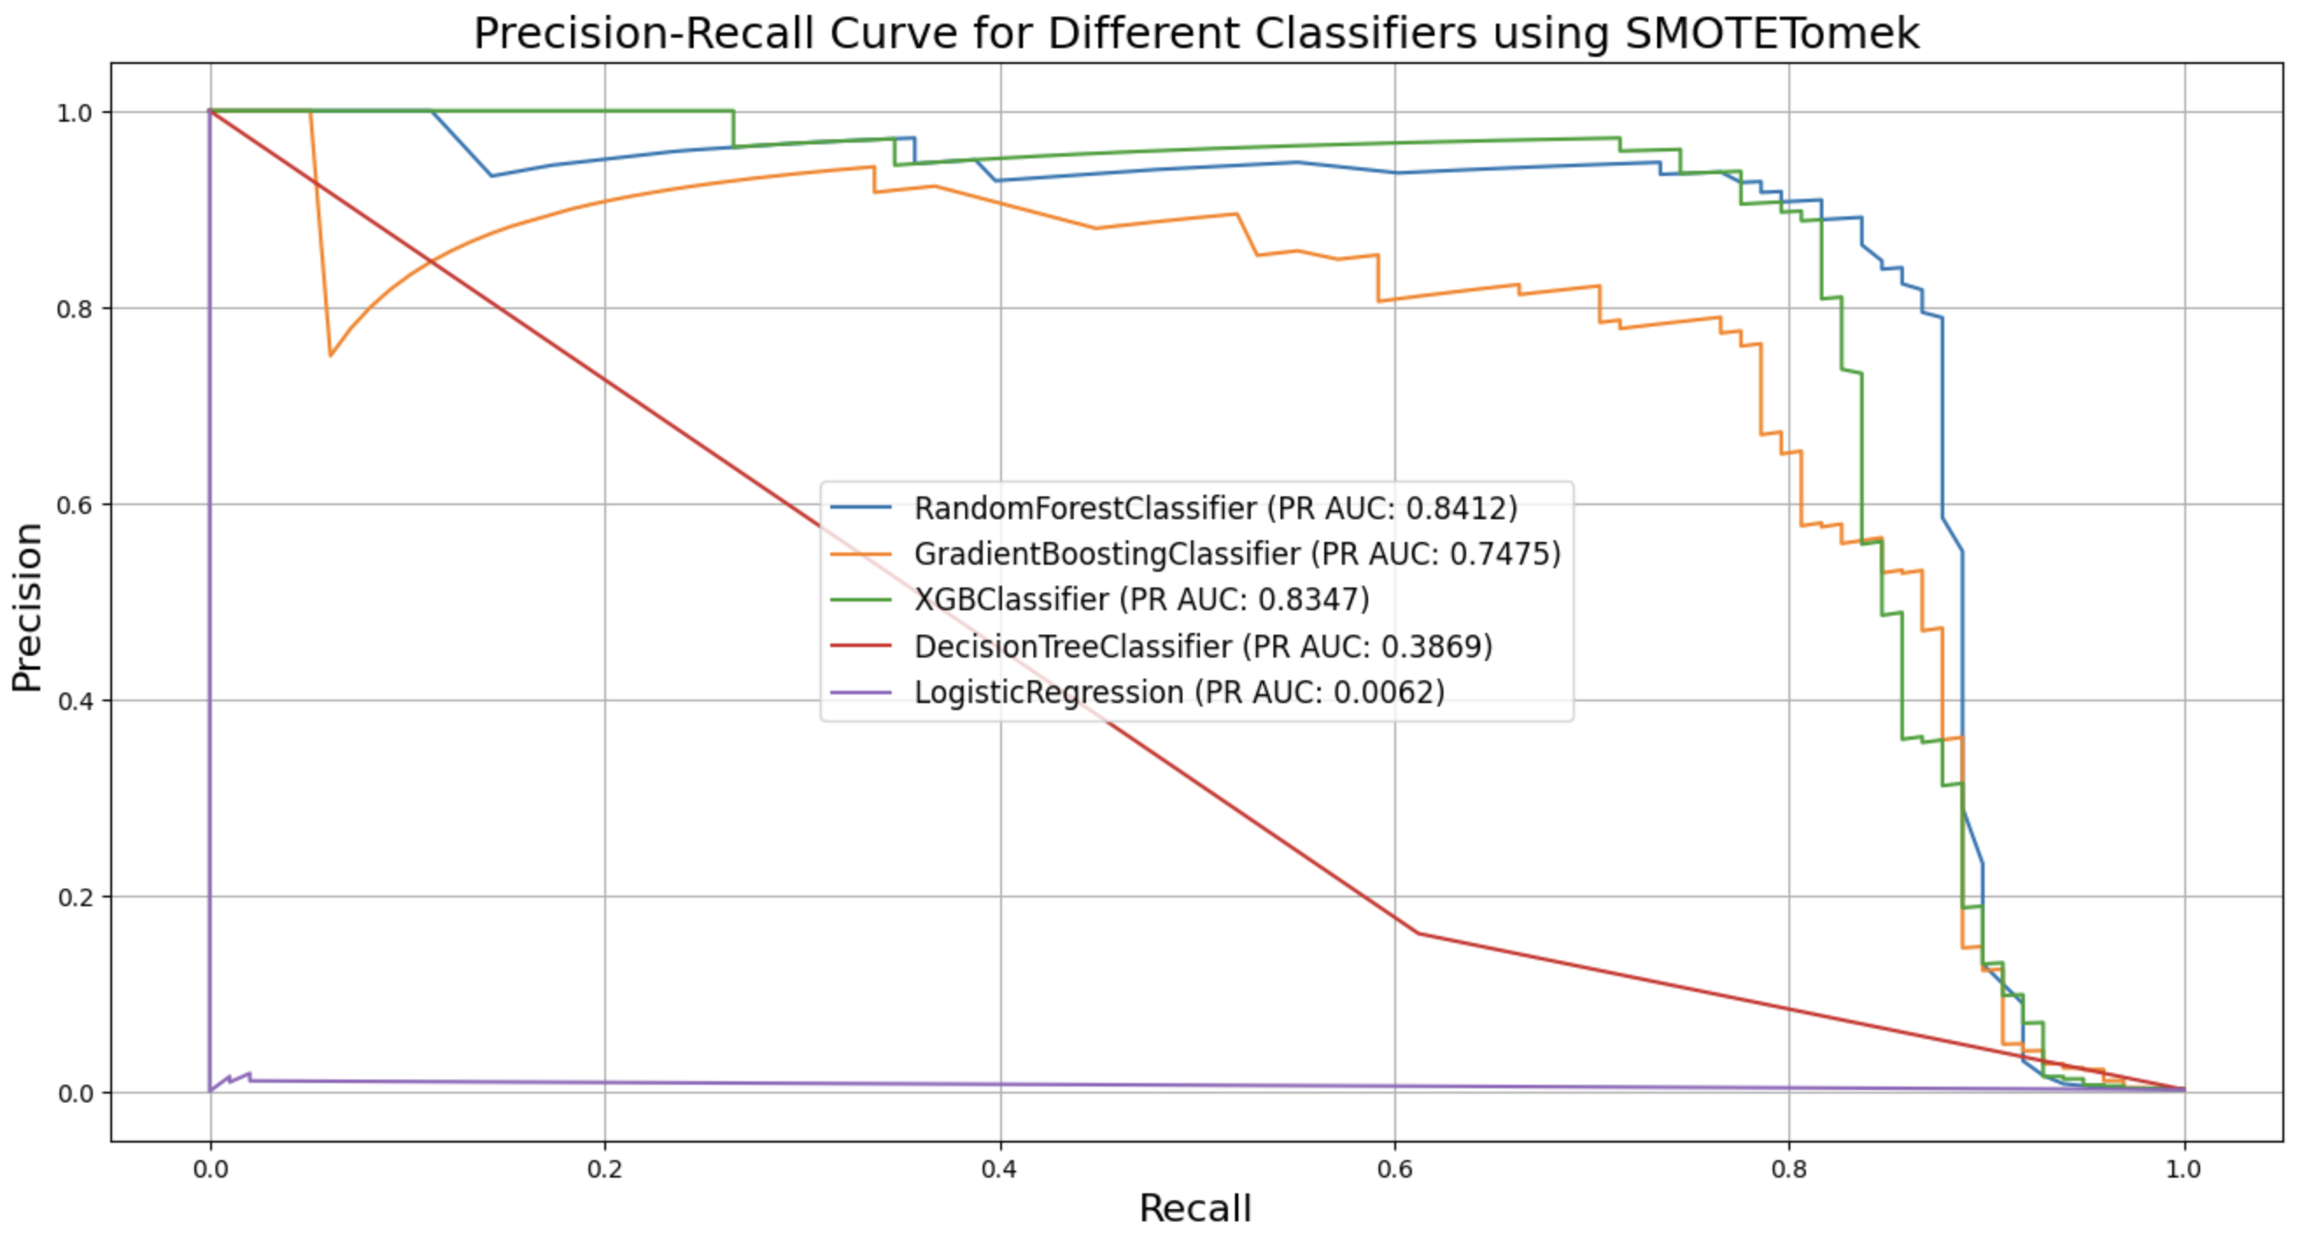
Model Performance with SMOTE Tomek

Slide 24
CONCLUSION
In this experiment, we evaluated the performance of five classifiers Random Forest, Gradient Boosting, XGBoost, Decision Tree, and Logistic Regression across five resampling methods (SMOTE, Random Over-Sampling, ADASYN, Borderline-SMOTE, and SMOTETomek) to detect fraudulent transactions.
The combination of the XGBClassifier with the BorderlineSMOTE oversampling technique achieved the highest PR AUC score of 0.86969, indicating superior predictive performance compared to other algorithm-oversampling pairs.
The RandomForestClassifier demonstrated strong and consistent performance across various oversampling methods, with PR AUC scores ranging from 0.823 to 0.840, making it a reliable choice for the dataset.
The DecisionTreeClassifier showed significant variability in performance (PR AUC scores ranging from 0.189 with BorderlineSMOTE to 0.749 with RandomOverSampler) due to its sensitivity to data distribution changes caused by different oversampling techniques.
The LogisticRegression algorithm consistently performed poorly across all oversampling techniques (PR AUC scores below 0.011), likely due to its linear nature and sensitivity to class imbalance, making it ill-suited for capturing the complex patterns in fraudulent transactions.

